Slide 1

50.039 Theory and Practice of Deep Learning W8-S1 Transition
Matthieu De Mari, Berrak Sisman

Slide 2

About me
Dr. Matt (Matthieu) DE MARI
Lecturer at SUTD (Python, Deep Learning, AI, and more)
Information Systems Technology and Design (ISTD) pillar/faculty
PhD from CentraleSupelec (France)
Email: matthieu_demari@sutd.edu.sg
Office @ SUTD: 1.702.27

Slide 3
Recap: Weeks 1-6
Week 1: General introduction, linear model for regression and classification, recap on gradients for machine learning.
Week 2: Introduction to PyTorch, classification using logistic regression. Basic concepts of Neural Networks.
Week 3: Backpropagation, initialization and data augmentation. Convolutional Neural Networks. PyTorch practice.
Week 4: Advanced optimizers and better ways to apply gradients. Transfer learning, brief state-of-the-art on computer vision architectures (ResNets, etc.). More PyTorch practice.
Week 5: Recurrent neural networks (RNNs) architectures.
Week 6: Conference. Midterm exam.

Slide 4

What is coming next?
At this point, you have learnt the basics of Deep Learning, i.e., what most online courses teach.
Advanced concepts are often missing online, as they are
open questions in research,
too niche for an online course
or simply not yet prepared into an online course.
In this second half of the 50.039 DL course, we propose to discuss some of these advanced concepts and research directions.

Slide 5
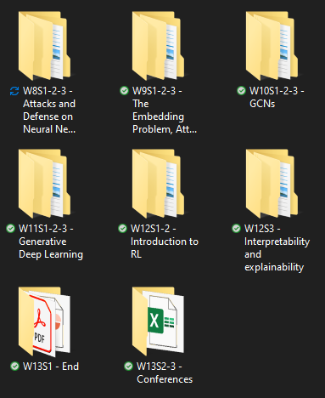
The way I teach things
Each week has a specific topic.
Notebooks demos that you can reuse for practice (autonomy is key).
Discussions about more advanced concepts (often out-of-scope).
Extra readings for those who are curious.
If time allows, homeworks/projects/exam feedbacks.
Materials uploaded each morning before class (or the day before class).
Homeworks given on Fridays.
Project announced on W5.

Slide 6
50.039 Theory and Practice of Deep Learning W8-S1 Introduction to Attacks and Defense on Neural Networks
Matthieu De Mari, Berrak Sisman

Slide 7
About this week (Week 8)
What are attacks on Neural Networks (NNs)?
Why are attacks an important concept when studying NNs?
What are the different types of attacks and what is the intuition behind basic attacks?
How to defend against such attacks?
State-of-the-art of attacks and defense, open questions in research.

Slide 8
About this week (Week 8)
What are attacks on Neural Networks (NNs)?
Why are attacks an important concept when studying NNs?
What are the different types of attacks and what is the intuition behind basic attacks?
How to defend against such attacks?
State-of-the-art of attacks and defense, open questions in research.

Slide 9



Attacks: definition
Definition (Attacks on Neural Networks):
Adversarial machine learning, or attacks on Neural Networks, refers to machine learning techniques that attempt to fool models by supplying deceptive input.
The most common reason is to cause a malfunction in a machine learning model.

Slide 10
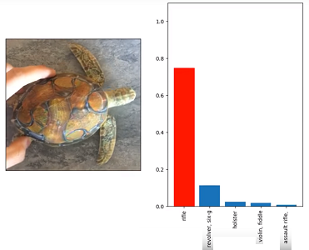
Attack/Adversarial samples: definition
Definition (Attack samples, adversarial samples):
An input sample is considered an attack sample (or adversarial sample) for a given trained model, if and only if, it makes this model malfunction on purpose.
Example: this picture of a turtle has been altered on some of its pixels to be misclassified as a weapon (rifle, revolver, etc.).
Source: Google’s AI thinks this turtle looks like a gun, which is a problem [Verge1].

Slide 11
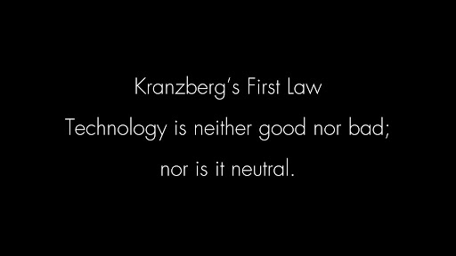

On the ethics of attacking Neural Networks
This week’s lectures and notebooks will introduce techniques, whose objective is to make a trained Neural Network malfunction on purpose.
These techniques are NOT, so to speak, illegal.
But let us keep in mind what the consequences of using these attacks could be…

Slide 12
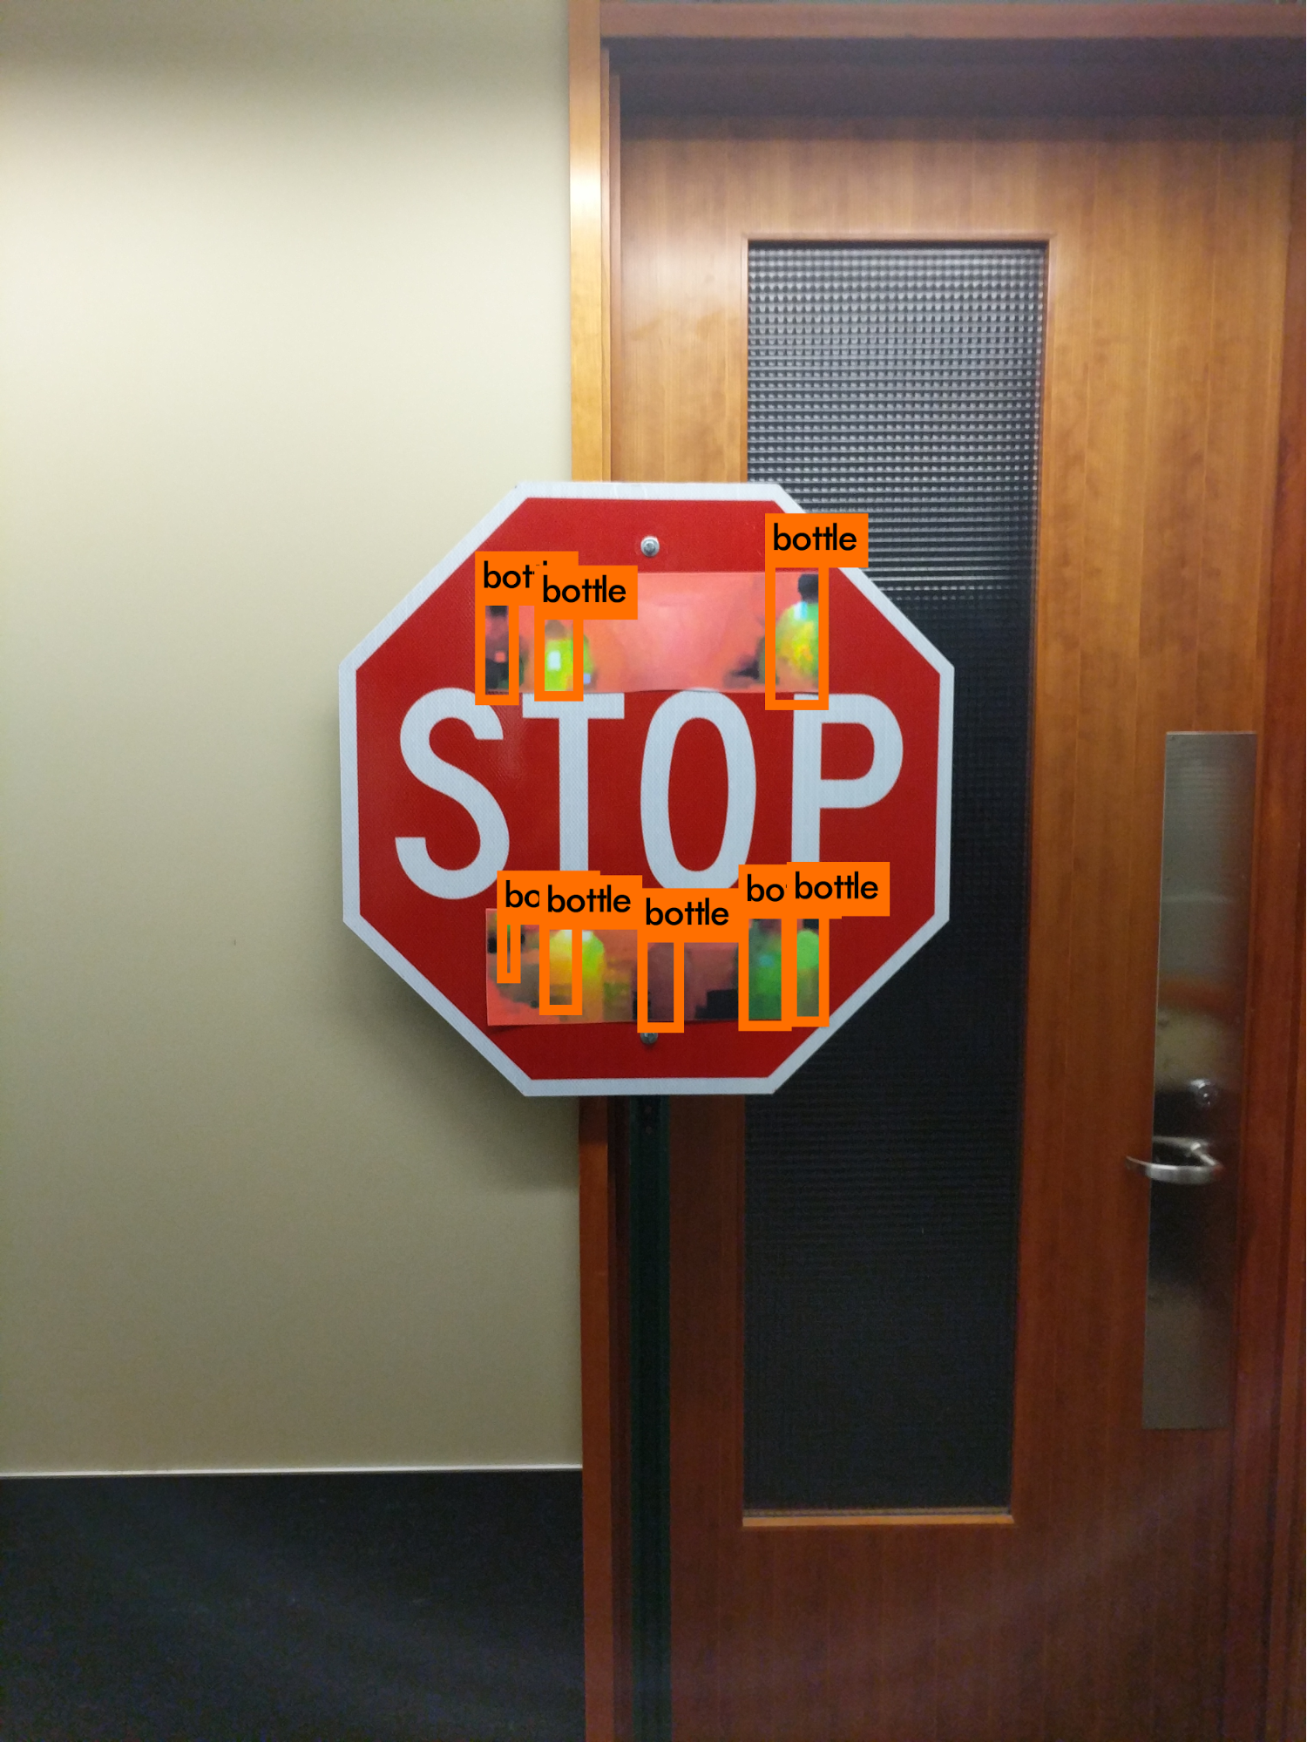
On the ethics of attacking Neural Networks
Example #1: This stop sign has stickers put in specific locations.
It is an attack sample as it can no longer be detected as a stop sign, and is instead misclassified as several bottles.
Think: What would be the effect/consequence of such an attack sample on a self-driving car using computer vision?
Source: Slight Street Sign Modifications Can Completely Fool Machine Learning Algorithms [Spectrum1].

Slide 13
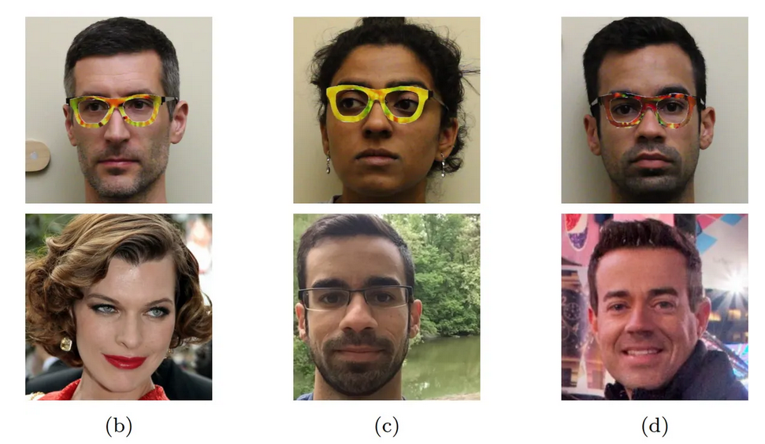
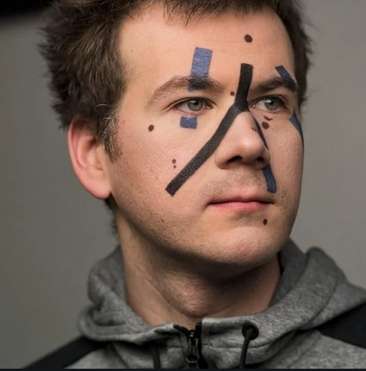
On the ethics of attacking Neural Networks
Example #2: Covering some areas of your face with paint or glasses with specific patterns can fool facial recognition algorithms.
These facial recognition AIs are no longer able to detect a face, let alone recognize the identity of the person.
Think: Is that a good or a bad discovery for computer vision?
Source: These glasses trick facial recognition software into thinking you're someone else [Verge2].
Source: Defeating Facial Recognition [YTB1].

Slide 14

Are you going to teach us about “hacking” Neural Networks then?!

Slide 15
Are you going to teach us about “hacking” Neural Networks then?!
No…?

Slide 16
Are you going to teach us about “hacking” Neural Networks then?!
Okay, yes, fine.

Slide 17
Are you going to teach us about “hacking” Neural Networks then?!
Okay, yes, fine.
But only for two reasons.
To teach you about limits/vulnerabilities of Neural Networks and how to defend them against such attacks.

Slide 18
Reason #1: Limits
Reason #1: Neural networks are limited and vulnerable, by design.
They will always be at risk of attacks making them malfunction, no matter how many safeguards you decide to put in place.

Slide 19
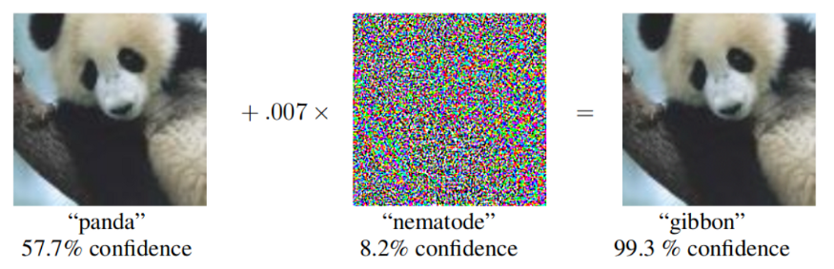
Reason #1: Limits
Reason #1: Neural networks are limited and vulnerable, by design.
They will always be at risk of attacks making them malfunction, no matter how many safeguards you decide to put in place.
For instance, adding noise to an image is often enough to fool any image recognition algorithm.

Slide 20
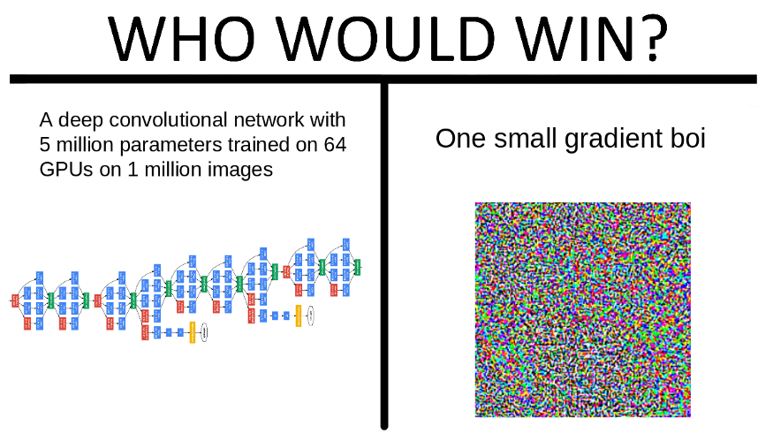
Reason #1: Limits
Reason #1: Neural networks are limited and vulnerable, by design.
They will always be at risk of attacks making them malfunction, no matter how many safeguards you decide to put in place.
For instance, adding noise to an image is often enough to fool any image recognition algorithm.
A deep convolutional network with 1 million parameters, trained for days on 64 GPUs, using a dataset of 1 million images

Slide 21
Reason #1: Limits
Reason #1: Neural networks are limited and vulnerable, by design.
They will always be at risk of attacks making them malfunction, no matter how many safeguards you decide to put in place.
For instance, adding noise to an image is often enough to fool any image recognition algorithm.
A deep convolutional network with 1 million parameters, trained for days on 64 GPUs, using a dataset of 1 million images

Slide 22
Reason #1: Limits
Reason #1: Neural networks are limited and vulnerable, by design.
They will always be at risk of attacks making them malfunction, no matter how many safeguards you decide to put in place.
For instance, adding noise to an image is often enough to fool any image recognition algorithm.
A deep convolutional network with 1 million parameters, trained for days on 64 GPUs, using a dataset of 1 million images
One small noise image boi, added to an original image

Slide 23
Reason #1: Limits
Neural networks are limited and vulnerable, by design.
They will always be at risk of attacks making them malfunction, no matter how many safeguards you decide to put in place.
For instance, adding noise to an image is often enough to fool any image recognition algorithm.
This raises two questions.
Shall we give up on neural networks then? No, because of reason #2, defense (more on this later).
But, wait, how does that even work?!
A deep convolutional network with 1 million parameters, trained for days on 64 GPUs, using a dataset of 1 million images
One small noise image boi, added to an original image

Slide 24
Reason #1: Limits
Neural networks are limited and vulnerable, by design.
They will always be at risk of attacks making them malfunction, no matter how many safeguards you decide to put in place.
For instance, adding noise to an image is often enough to fool any image recognition algorithm.
This raises two questions.
Shall we give up on neural networks then? No, because of reason #2, defense (more on this later).
But, wait, how does that even work?!
A deep convolutional network with 1 million parameters, trained for days on 64 GPUs, using a dataset of 1 million images
One small noise image boi, added to an original image

Slide 25
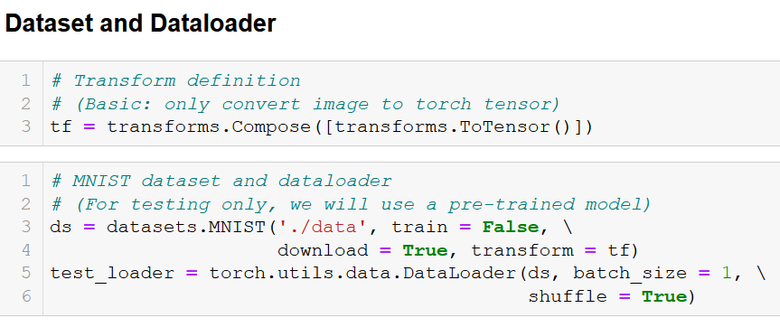
Before we start
Please refer to Notebook 1. Using Epsilon Noising Attack to Generate Attack Samples.
All notebooks this week follow the same structure
Dataset and Dataloader

Slide 26

Before we start
Please refer to Notebook 1. Using Epsilon Noising Attack to Generate Attack Samples.
All notebooks this week follow the same structure
Dataset and Dataloader
Model

Slide 27
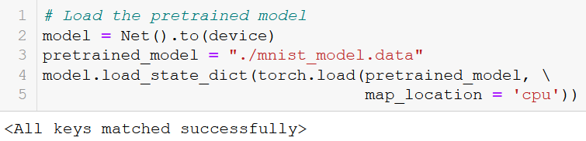
Before we start
Please refer to Notebook 1. Using Epsilon Noising Attack to Generate Attack Samples.
All notebooks this week follow the same structure
Dataset and Dataloader
(Pre-trained) Model

Slide 28
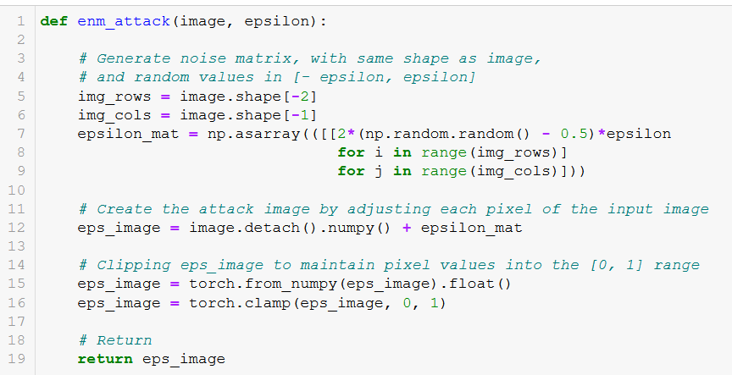
Before we start
Please refer to Notebook 1. Using Epsilon Noising Attack to Generate Attack Samples.
All notebooks this week follow the same structure
Dataset and Dataloader
(Pre-trained) Model
Attack function

Slide 29
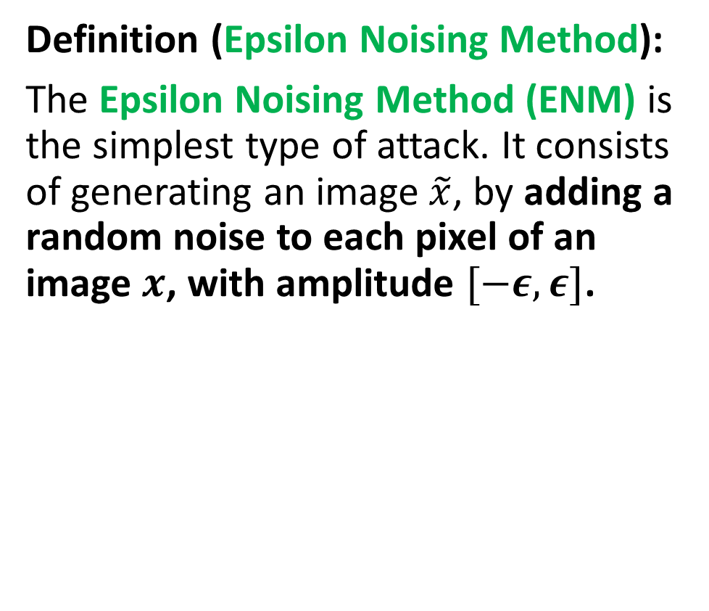
Our first attack: Epsilon Noising
Definition (Epsilon Noising Method):
The Epsilon Noising Method (ENM) is the simplest type of attack. It consists of generating an image $\tilde{x}$, by adding a random noise to each pixel of an image $x$, with amplitude $[−ε, ε]$.

Slide 30
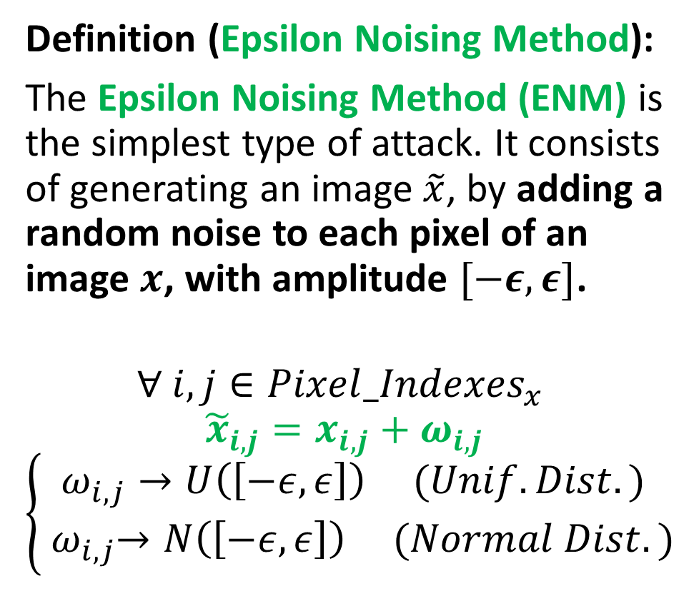
Our first attack: Epsilon Noising
Definition (Epsilon Noising Method):
The Epsilon Noising Method (ENM) is the simplest type of attack. It consists of generating an image $\tilde{x}$, by adding a random noise to each pixel of an image $x$, with amplitude $[−ε, ε]$.
$$∀ i,j∈{Pixel_Indexes}_{x}$$
$${\tilde{x}}_{i,j}=x_{i,j}+ω_{i,j}$$
$$\left\{\begin{matrix}ω_{i,j}→U\left(\left[−ε, ε\right]\right) (Unif. Dist.) \\ { ω}_{i,j}→N\left(\left[−ε, ε\right]\right) (Normal Dist.)\end{matrix}\right.$$

Slide 31
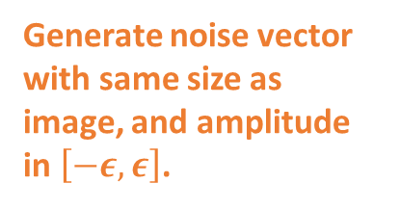
Our first attack: Epsilon Noising
Generate noise vector with same size as image, and amplitude in $\left[−ε, ε\right]$.
Definition (Epsilon Noising Method):
The Epsilon Noising Method (ENM) is the simplest type of attack. It consists of generating an image $\tilde{x}$, by adding a random noise to each pixel of an image $x$, with amplitude $[−ε, ε]$.
$$∀ i,j∈{Pixel_Indexes}_{x}$$
$${\tilde{x}}_{i,j}=x_{i,j}+ω_{i,j}$$
$$\left\{\begin{matrix}ω_{i,j}→U\left(\left[−ε, ε\right]\right) (Unif. Dist.) \\ { ω}_{i,j}→N\left(\left[−ε, ε\right]\right) (Normal Dist.)\end{matrix}\right.$$

Slide 32
Our first attack: Epsilon Noising
Add noise to original image.
Definition (Epsilon Noising Method):
The Epsilon Noising Method (ENM) is the simplest type of attack. It consists of generating an image $\tilde{x}$, by adding a random noise to each pixel of an image $x$, with amplitude $[−ε, ε]$.
$$∀ i,j∈{Pixel_Indexes}_{x}$$
$${\tilde{x}}_{i,j}=x_{i,j}+ω_{i,j}$$
$$\left\{\begin{matrix}ω_{i,j}→U\left(\left[−ε, ε\right]\right) (Unif. Dist.) \\ { ω}_{i,j}→N\left(\left[−ε, ε\right]\right) (Normal Dist.)\end{matrix}\right.$$

Slide 33
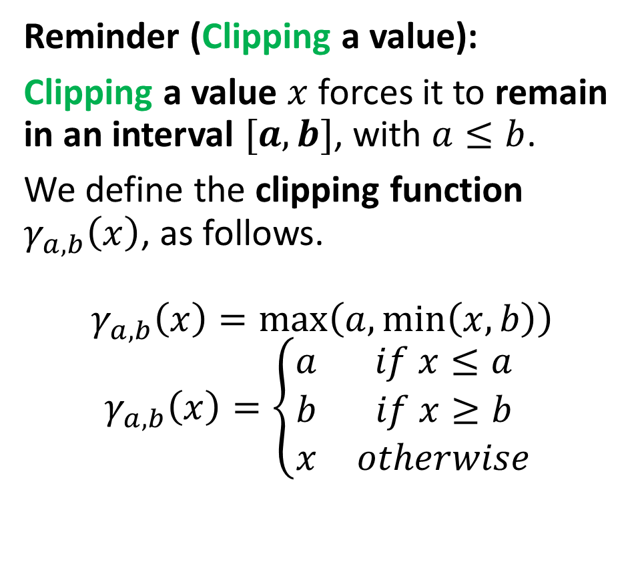
Our first attack: Epsilon Noising
Clipping to prevent unwanted pixel values.
(Normalization taken into account)
Reminder (Clipping a value):
Clipping a value $x$forces it to remain in an interval $[a,b]$, with $a≤b$.
We define the clipping function $γ_{a,b}\left(x\right)$, as follows.
$$γ_{a,b}\left(x\right)=\max\left(a,\min\left(x, b\right)\right)$$
$$γ_{a,b}\left(x\right)=\left\{\begin{matrix}a & if x≤a \\ b & if x≥b \\ x & otherwise\end{matrix}\right.$$

Slide 34
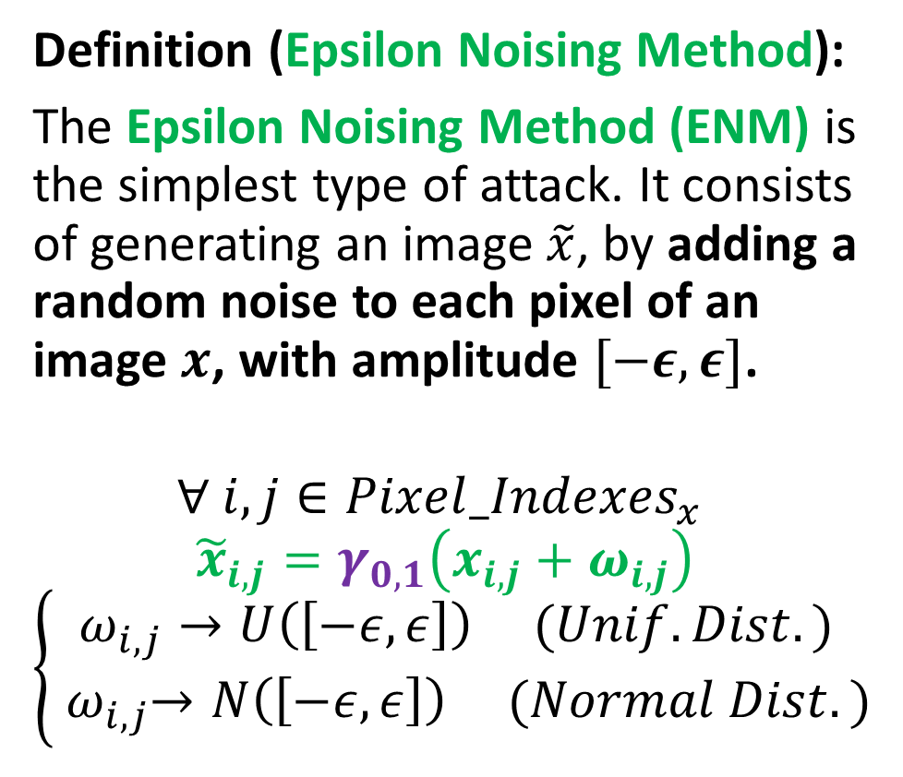
Our first attack: Epsilon Noising
Clipping to prevent pixel values to go out of [0, 1].
(Normalization taken into account)
Definition (Epsilon Noising Method):
The Epsilon Noising Method (ENM) is the simplest type of attack. It consists of generating an image $\tilde{x}$, by adding a random noise to each pixel of an image $x$, with amplitude $[−ε, ε]$.
$$∀ i,j∈{Pixel_Indexes}_{x}$$
$${\tilde{x}}_{i,j}=γ_{0,1}\left(x_{i,j}+ω_{i,j}\right)$$
$$\left\{\begin{matrix}ω_{i,j}→U\left(\left[−ε, ε\right]\right) (Unif. Dist.) \\ { ω}_{i,j}→N\left(\left[−ε, ε\right]\right) (Normal Dist.)\end{matrix}\right.$$

Slide 35
Our first attack: Epsilon Noising
Add noise to original image.
Definition (Epsilon Noising Method):
The Epsilon Noising Method (ENM) is the simplest type of attack. It consists of generating an image $\tilde{x}$, by adding a random noise to each pixel of an image $x$, with amplitude $[−ε, ε]$.
$$∀ i,j∈{Pixel_Indexes}_{x}$$
$${\tilde{x}}_{i,j}=γ_{0,1}\left(x_{i,j}+ω_{i,j}\right)$$
$$\left\{\begin{matrix}ω_{i,j}→U\left(\left[−ε, ε\right]\right) (Unif. Dist.) \\ { ω}_{i,j}→N\left(\left[−ε, ε\right]\right) (Normal Dist.)\end{matrix}\right.$$

Slide 36
Before we start
Please refer to Notebook 1. Using Epsilon Noising Attack to Generate Attack Samples.
All notebooks this week follow the same structure
Dataset and Dataloader
(Pre-trained) Model
Attack function

Slide 37
Before we start
Please refer to Notebook 1. Using Epsilon Noising Attack to Generate Attack Samples.
All notebooks this week follow the same structure
Dataset and Dataloader
(Pre-trained) Model
Attack function
Testing effect of attack on model

Slide 38
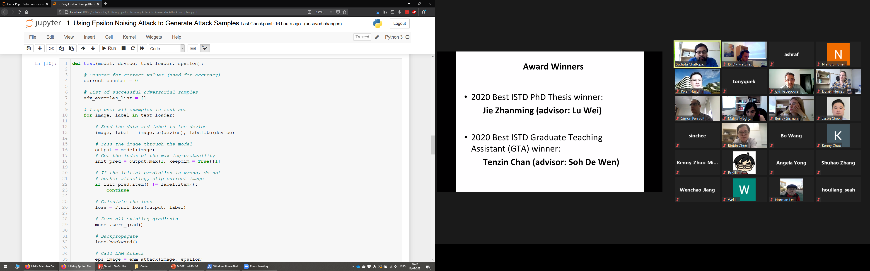
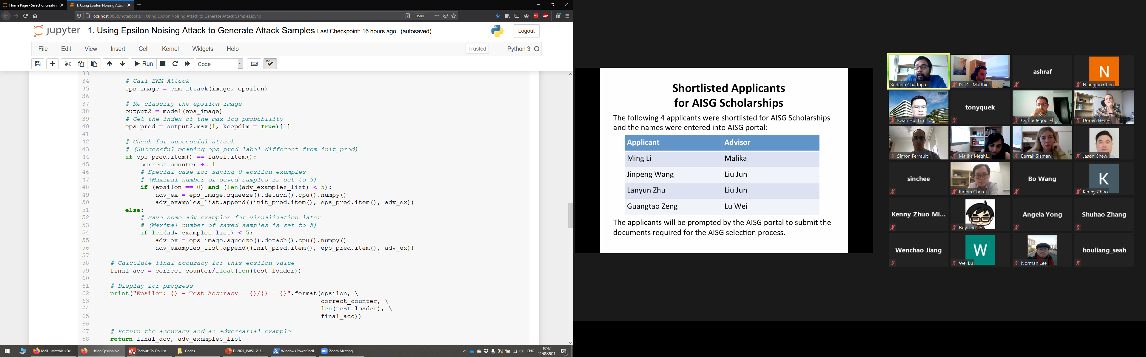
Testing Function
This function attempts to 1) track how an attack with amplitude epsilon, used on the samples in the test_loader will affect our model;
Please refer to Notebook 1. Using Epsilon Noising Attack to Generate Attack Samples.
All notebooks this week follow the same structure
Dataset and Dataloader
(Pre-trained) Model
Attack function
Testing effect of attack on model

Slide 39
Testing Function
This function attempts to 1) track how an attack with amplitude epsilon, used on the samples in the test_loader will affect our model;
and 2) return attack samples that worked for later visualization.
Please refer to Notebook 1. Using Epsilon Noising Attack to Generate Attack Samples.
All notebooks this week follow the same structure
Dataset and Dataloader
(Pre-trained) Model
Attack function
Testing effect of attack on model

Slide 40
Testing Function
This will track how many samples were correctly classified despite the attack being performed on the test samples.
Please refer to Notebook 1. Using Epsilon Noising Attack to Generate Attack Samples.
All notebooks this week follow the same structure
Dataset and Dataloader
(Pre-trained) Model
Attack function
Testing effect of attack on model

Slide 41
Testing Function
This will store up to 5 attack samples that made the model malfunction
(used for visualization later).
Please refer to Notebook 1. Using Epsilon Noising Attack to Generate Attack Samples.
All notebooks this week follow the same structure
Dataset and Dataloader
(Pre-trained) Model
Attack function
Testing effect of attack on model

Slide 42
Testing Function
This is very typical for our test functions so far, just browsing through (normal) test samples and trying those on our model.
Please refer to Notebook 1. Using Epsilon Noising Attack to Generate Attack Samples.
All notebooks this week follow the same structure
Dataset and Dataloader
(Pre-trained) Model
Attack function
Testing effect of attack on model

Slide 43
Testing Function
If the model already misclassifies the sample, do not bother attacking
(Attack could make the model right!).
Please refer to Notebook 1. Using Epsilon Noising Attack to Generate Attack Samples.
All notebooks this week follow the same structure
Dataset and Dataloader
(Pre-trained) Model
Attack function
Testing effect of attack on model

Slide 44
Testing Function
This is again very typical. Right now, it does not appear necessary, but more advanced attacks will rely on the gradients of the model, and that would be the way to compute them (more on this later!).
Please refer to Notebook 1. Using Epsilon Noising Attack to Generate Attack Samples.
All notebooks this week follow the same structure
Dataset and Dataloader
(Pre-trained) Model
Attack function
Testing effect of attack on model

Slide 45
Testing Function
Generate an attack sample, using our ENM attack function.
Please refer to Notebook 1. Using Epsilon Noising Attack to Generate Attack Samples.
All notebooks this week follow the same structure
Dataset and Dataloader
(Pre-trained) Model
Attack function
Testing effect of attack on model

Slide 46
Testing Function
Try attack sample on our model.
Please refer to Notebook 1. Using Epsilon Noising Attack to Generate Attack Samples.
All notebooks this week follow the same structure
Dataset and Dataloader
(Pre-trained) Model
Attack function
Testing effect of attack on model

Slide 47
Testing Function
If attack sample is correctly classified, the attack is a failure.
Increase correct score by one.
Please refer to Notebook 1. Using Epsilon Noising Attack to Generate Attack Samples.
All notebooks this week follow the same structure
Dataset and Dataloader
(Pre-trained) Model
Attack function
Testing effect of attack on model

Slide 48
Testing Function
Add sample to adversarial samples list if epsilon = 0 and list not full (attacking with epsilon = 0 will always fail as it will not modify the image).
This gives the baseline accuracy of the model before attacks.
Please refer to Notebook 1. Using Epsilon Noising Attack to Generate Attack Samples.
All notebooks this week follow the same structure
Dataset and Dataloader
(Pre-trained) Model
Attack function
Testing effect of attack on model

Slide 49
Testing Function
If attack sample makes the model misclassify, it is a successful attack.
Do not increase correct_counter, and store sample in adversarial samples list if not already full.
Please refer to Notebook 1. Using Epsilon Noising Attack to Generate Attack Samples.
All notebooks this week follow the same structure
Dataset and Dataloader
(Pre-trained) Model
Attack function
Testing effect of attack on model

Slide 50
Testing Function
After the for loop, compute accuracy of model after attack.
Please refer to Notebook 1. Using Epsilon Noising Attack to Generate Attack Samples.
All notebooks this week follow the same structure
Dataset and Dataloader
(Pre-trained) Model
Attack function
Testing effect of attack on model

Slide 51
Testing Function
Display accuracy for given epsilon value.
Return accuracy score and the list of five adversarial samples.
Please refer to Notebook 1. Using Epsilon Noising Attack to Generate Attack Samples.
All notebooks this week follow the same structure
Dataset and Dataloader
(Pre-trained) Model
Attack function
Testing effect of attack on model

Slide 52
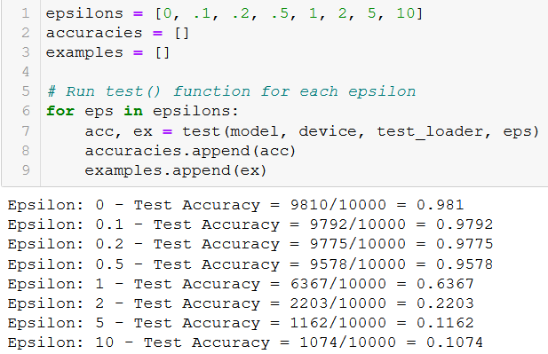
Before we start
Please refer to Notebook 1. Using Epsilon Noising Attack to Generate Attack Samples.
All notebooks this week follow the same structure
Dataset and Dataloader
(Pre-trained) Model
Attack function
Testing effect of attack on model

Slide 53
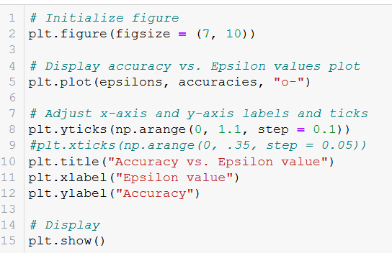
Before we start
Display a simple plot of accuracy vs. epsilon value for our given attack and model.
Please refer to Notebook 1. Using Epsilon Noising Attack to Generate Attack Samples.
All notebooks this week follow the same structure
Dataset and Dataloader
(Pre-trained) Model
Attack function
Testing effect of attack on model
Accuracy drop and attack samples visualization

Slide 54
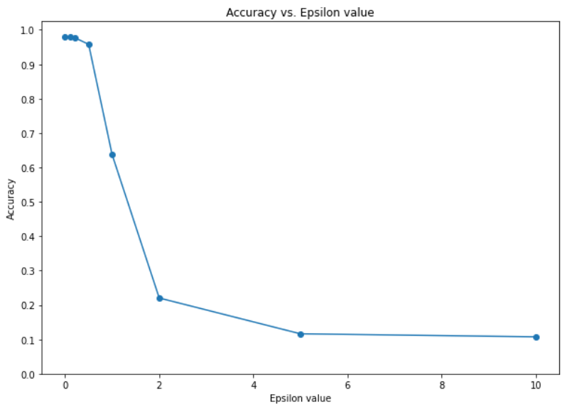
Before we start
Display a simple plot of accuracy vs. epsilon value for our given attack and model.
Please refer to Notebook 1. Using Epsilon Noising Attack to Generate Attack Samples.
All notebooks this week follow the same structure
Dataset and Dataloader
(Pre-trained) Model
Attack function
Testing effect of attack on model
Accuracy drop and attack samples visualization

Slide 55
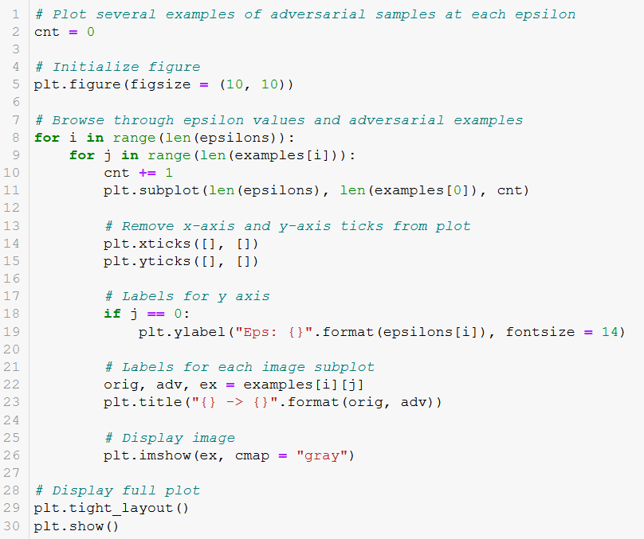
Before we start
Display some adversarial samples for each value of epsilon.
Please refer to Notebook 1. Using Epsilon Noising Attack to Generate Attack Samples.
All notebooks this week follow the same structure
Dataset and Dataloader
(Pre-trained) Model
Attack function
Testing effect of attack on model
Accuracy drop and attack samples visualization

Slide 56
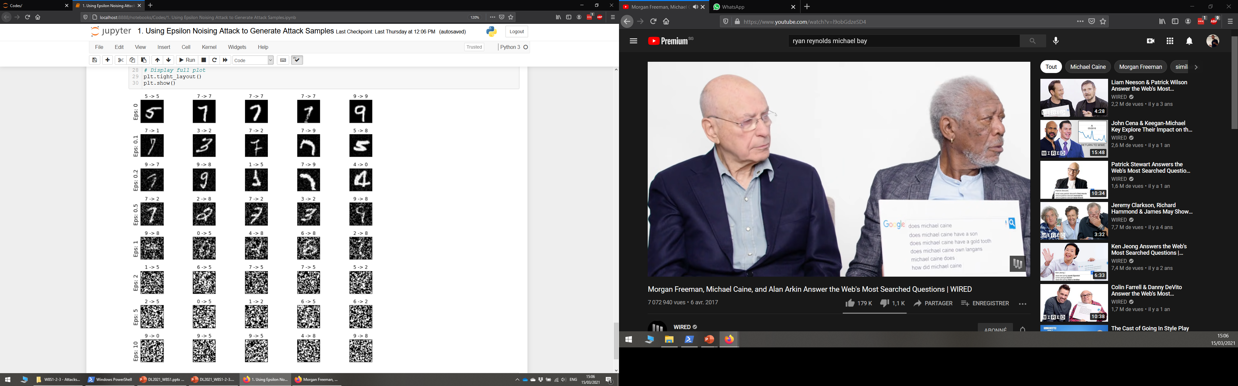
Before we start
Display some adversarial samples for each value of epsilon.
Please refer to Notebook 1. Using Epsilon Noising Attack to Generate Attack Samples.
All notebooks this week follow the same structure
Dataset and Dataloader
(Pre-trained) Model
Attack function
Testing effect of attack on model
Accuracy drop and attack samples visualization

Slide 57
Before we start
Please refer to Notebook 1. Using Epsilon Noising Attack to Generate Attack Samples.
All notebooks this week follow the same structure
Dataset and Dataloader
(Pre-trained) Model
Attack function
Testing effect of attack on model
Accuracy drop and attack samples visualization
Defense against such an attack

Slide 58
Before we start
Please refer to Notebook 1. Using Epsilon Noising Attack to Generate Attack Samples.
All notebooks this week follow the same structure
Dataset and Dataloader
(Pre-trained) Model
Attack function
Testing effect of attack on model
Accuracy drop and attack samples visualization
Defense against such an attack
SOMETHING FOR LATER…

Slide 59
Effect of ENM on accuracy
Adding noise to an image tends to make the model malfunction.
When no noise (epsilon = 0), 98.1% accuracy.
This is our baseline accuracy.

Slide 60
Effect of ENM on accuracy
Adding noise to an image tends to make the model malfunction.
When no noise (epsilon = 0), 98.1% accuracy.
This is our baseline accuracy.
Accuracy decreases, the further we increment the noise amplitude epsilon.

Slide 61
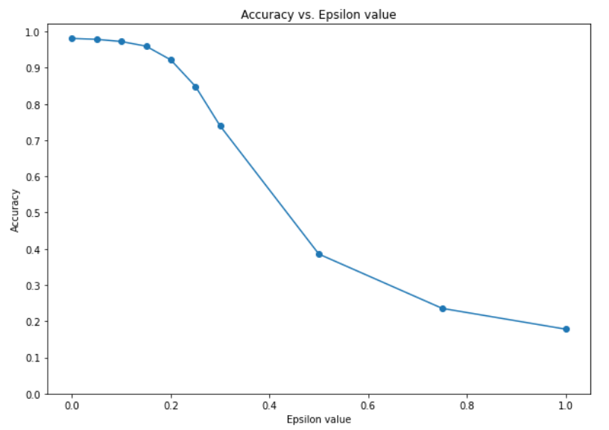
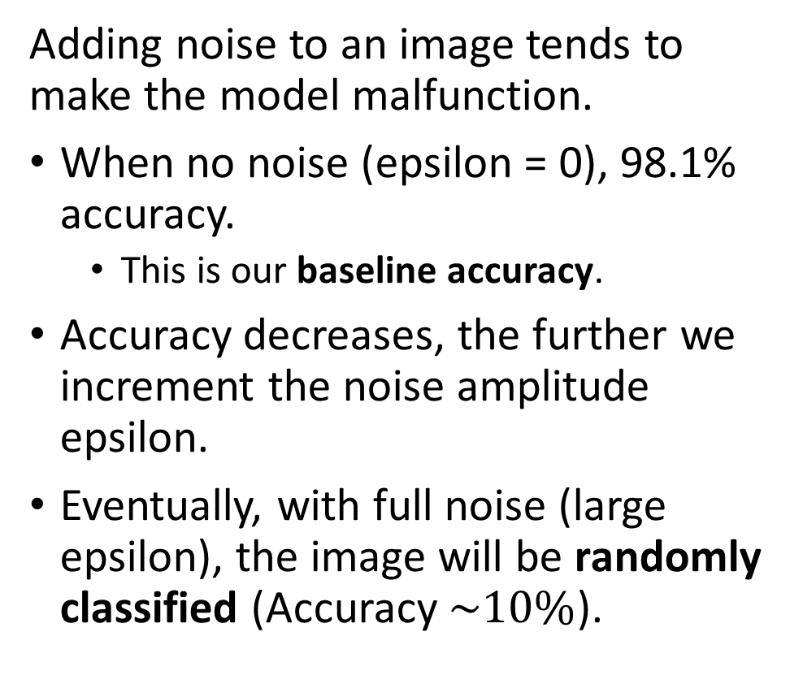
Effect of ENM on accuracy
Adding noise to an image tends to make the model malfunction.
When no noise (epsilon = 0), 98.1% accuracy.
This is our baseline accuracy.
Accuracy decreases, the further we increment the noise amplitude epsilon.
Eventually, with full noise (large epsilon), the image will be randomly classified (Accuracy $\sim 10\%$).

Slide 62
What makes a good attack sample?
However, for large values of epsilon, the attack samples simply become random noise.

Slide 63
What makes a good attack sample?
However, for large values of epsilon, the attack samples simply become random noise.
This is mostly why the classifier ends up struggling.

Slide 64
What makes a good attack sample?
However, for large values of epsilon, the attack samples simply become random noise.
This is mostly why the classifier ends up struggling.
These are NOT considered good attack samples!
(Think: humans would struggle to classify those as well!)

Slide 65
What makes a good attack sample?
Definition (what makes a “good” attack sample):
A “good” attack sample satisfies two properties:
Model failure: it makes the model malfunction.
Plausibility: It looks “plausible” or “normal” to a human. It looks like it could have been a sample from the dataset.

Slide 66
Attack samples tradeoff
Definition (attack samples tradeoff in adversarial ML):
Attack samples are subject to a tradeoff. In general,
the higher the odds of the attack sample to make the model malfunction,
the less plausible it will look.
Attack sample efficacy
Attack sample plausibility
vs.

Slide 67
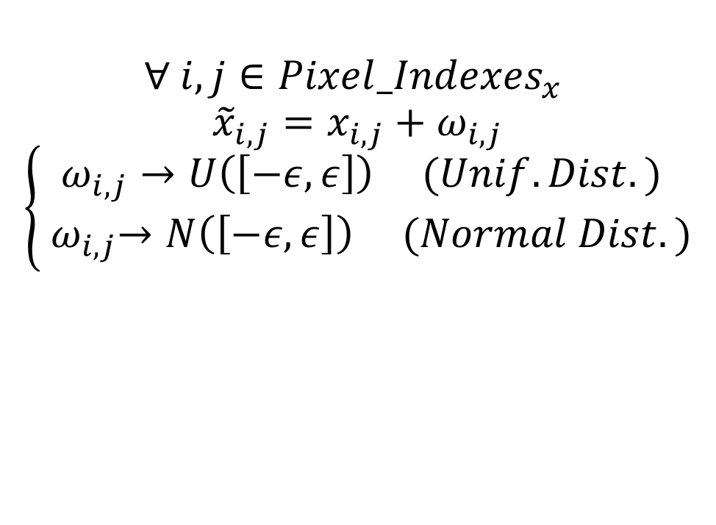
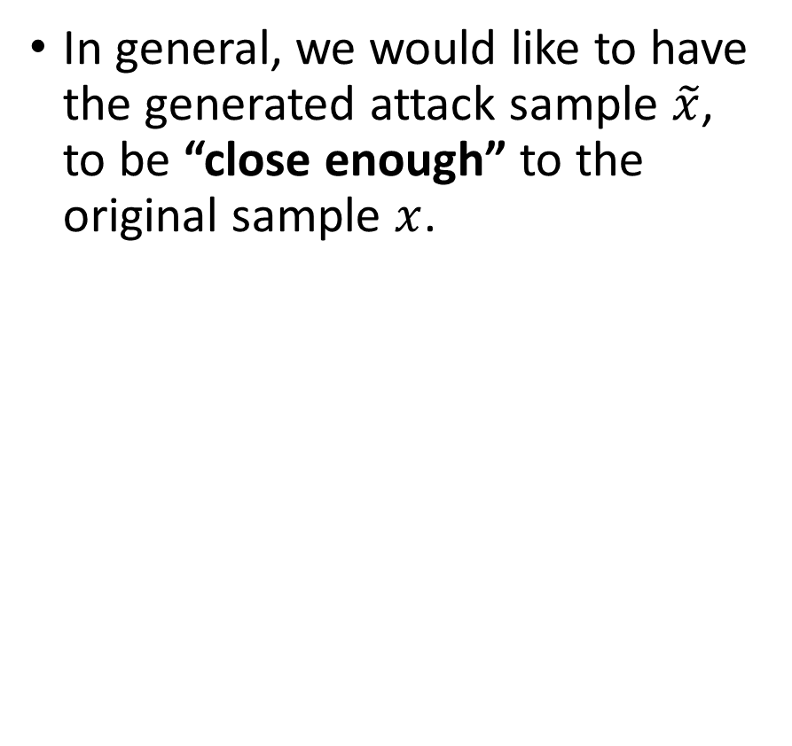
Plausibility
In general, we would like to have the generated attack sample $\tilde{x}$, to be “close enough” to the original sample $x$.
$$∀ i,j∈{Pixel_Indexes}_{x}$$
$${\tilde{x}}_{i,j}=x_{i,j}+ω_{i,j}$$
$$\left\{\begin{matrix}ω_{i,j}→U\left(\left[−ε, ε\right]\right) (Unif. Dist.) \\ { ω}_{i,j}→N\left(\left[−ε, ε\right]\right) (Normal Dist.)\end{matrix}\right.$$

Slide 68
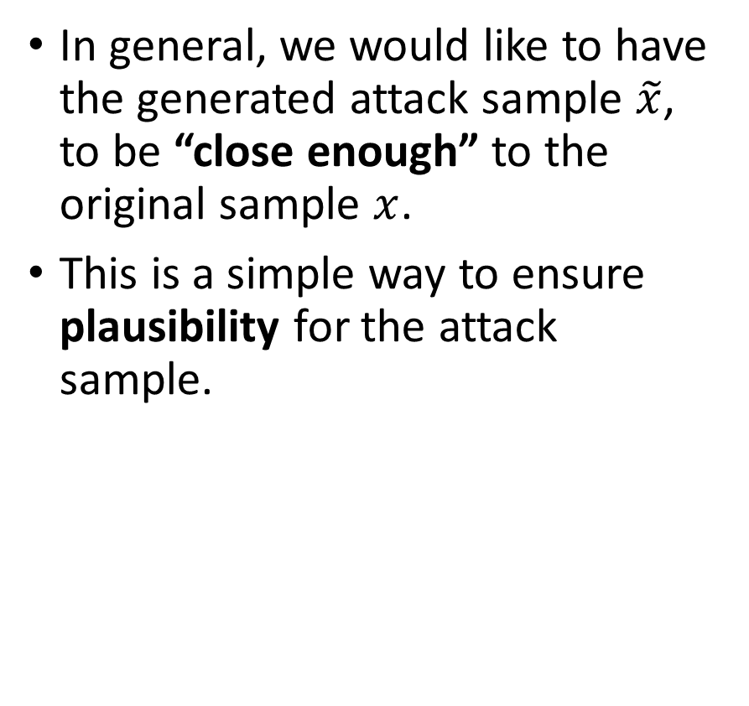
Plausibility
In general, we would like to have the generated attack sample $\tilde{x}$, to be “close enough” to the original sample $x$.
This is a simple way to ensure plausibility for the attack sample.
$$∀ i,j∈{Pixel_Indexes}_{x}$$
$${\tilde{x}}_{i,j}=x_{i,j}+ω_{i,j}$$
$$\left\{\begin{matrix}ω_{i,j}→U\left(\left[−ε, ε\right]\right) (Unif. Dist.) \\ { ω}_{i,j}→N\left(\left[−ε, ε\right]\right) (Normal Dist.)\end{matrix}\right.$$

Slide 69
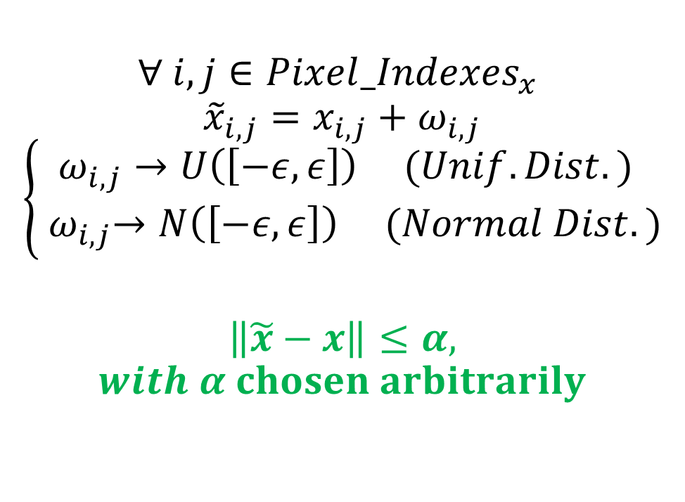
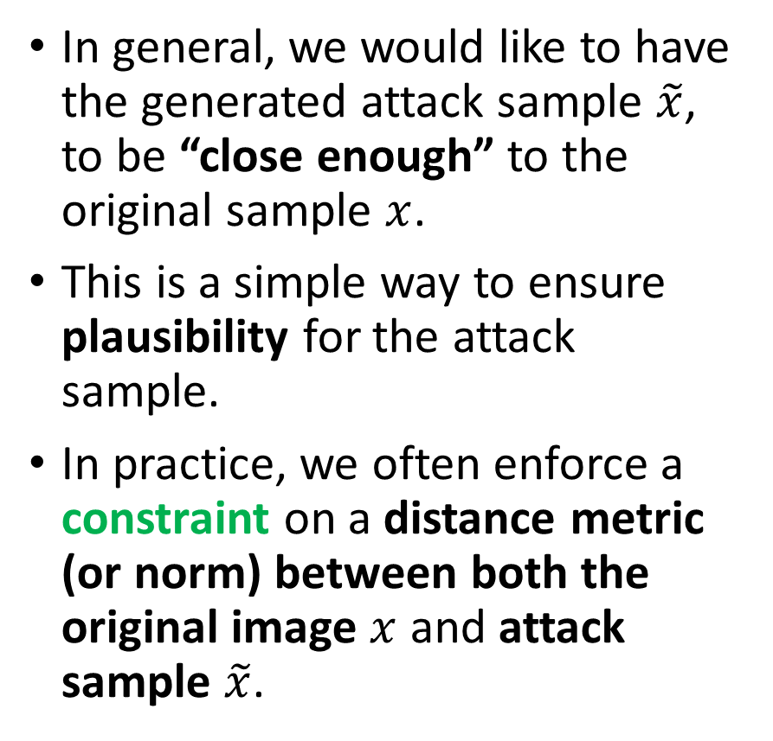
Plausibility
In general, we would like to have the generated attack sample $\tilde{x}$, to be “close enough” to the original sample $x$.
This is a simple way to ensure plausibility for the attack sample.
In practice, we often enforce a constraint on a distance metric (or norm) between both the original image $x$ and attack sample $\tilde{x}$.
$$∀ i,j∈{Pixel_Indexes}_{x}$$
$${\tilde{x}}_{i,j}=x_{i,j}+ω_{i,j}$$
$$\left\{\begin{matrix}ω_{i,j}→U\left(\left[−ε, ε\right]\right) (Unif. Dist.) \\ { ω}_{i,j}→N\left(\left[−ε, ε\right]\right) (Normal Dist.)\end{matrix}\right.$$
$$\left\|\tilde{x}−x\right\|≤α,$$
$$with α chosen arbitrarily$$

Slide 70
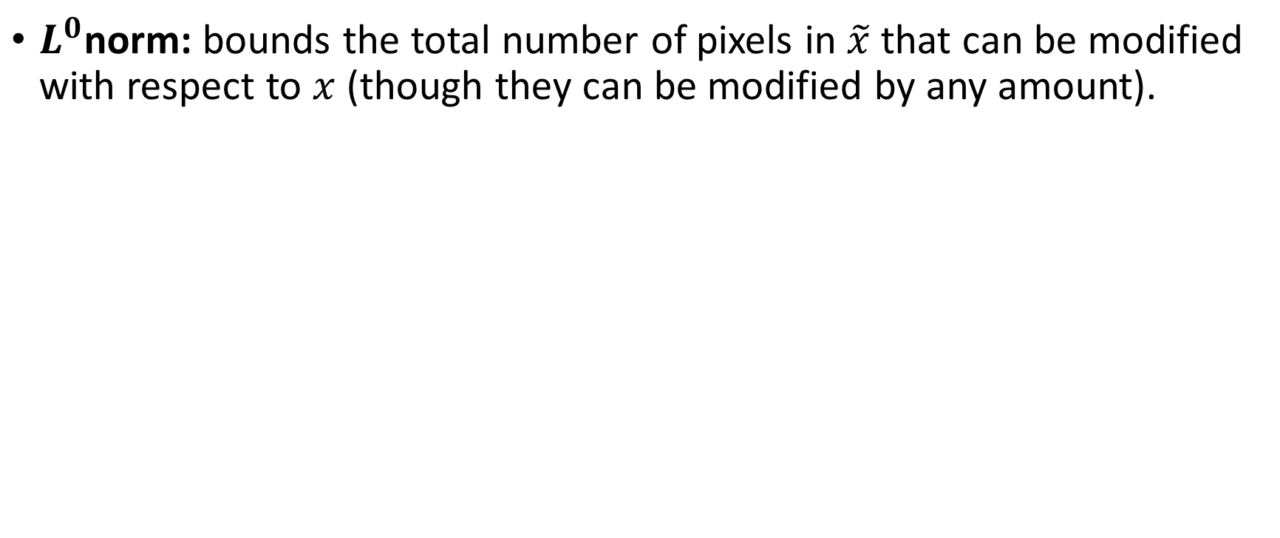
A reminder about norms
$L^{0}$norm: bounds the total number of pixels in $\tilde{x}$ that can be modified with respect to $x$ (though they can be modified by any amount).
$${\left\|\tilde{x}−x\right\|}_{0}=card\left(\left\{\left(i,j\right) s.t. x_{i,j}≠{\tilde{x}}_{i,j}\right\}\right)$$

Slide 71
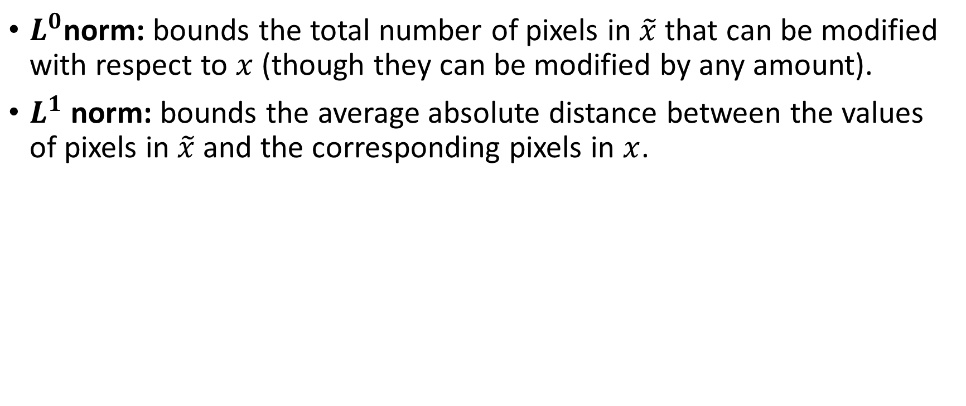
A reminder about norms
$L^{0}$norm: bounds the total number of pixels in $\tilde{x}$ that can be modified with respect to $x$ (though they can be modified by any amount).
$L^{1}$ norm: bounds the average absolute distance between the values of pixels in $\tilde{x}$and the corresponding pixels in $x$.
$${\left\|\tilde{x}−x\right\|}_{1}=\frac{1}{N}\sum_{i,j}{\left|{\tilde{x}}_{i,j}−x_{i,j}\right|, with N the number of pixels}$$

Slide 72
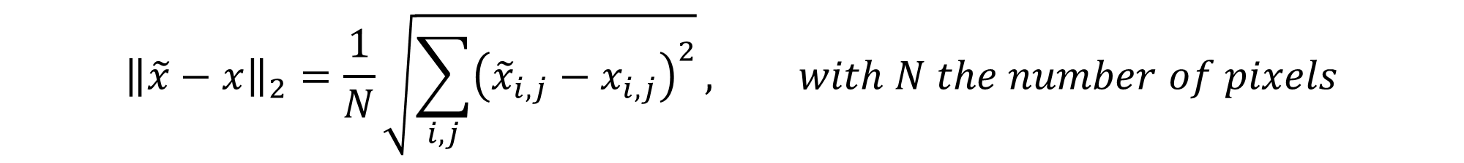
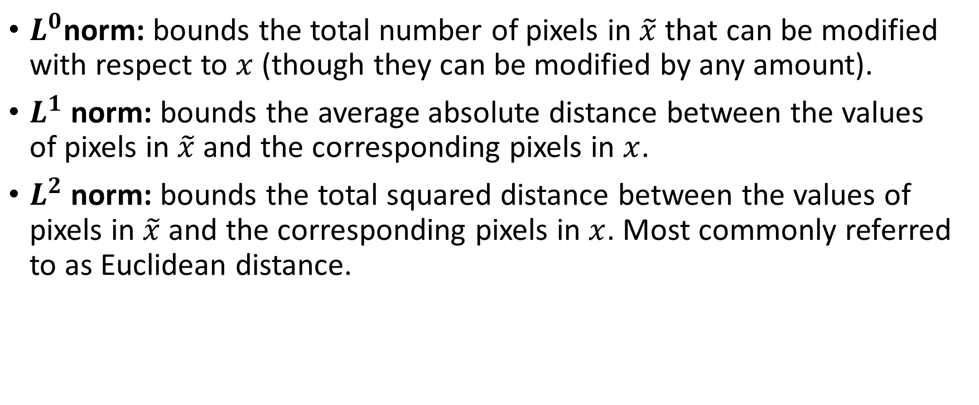
A reminder about norms
$L^{0}$norm: bounds the total number of pixels in $\tilde{x}$ that can be modified with respect to $x$ (though they can be modified by any amount).
$L^{1}$ norm: bounds the average absolute distance between the values of pixels in $\tilde{x}$and the corresponding pixels in $x$.
$L^{2}$ norm: bounds the total squared distance between the values of pixels in $\tilde{x}$and the corresponding pixels in $x$. Most commonly referred to as Euclidean distance.
$${\left\|\tilde{x}−x\right\|}_{2}=\frac{1}{N}\sqrt{\sum_{i,j}{{\left({\tilde{x}}_{i,j}−x_{i,j}\right)}^{2}}}, with N the number of pixels$$

Slide 73
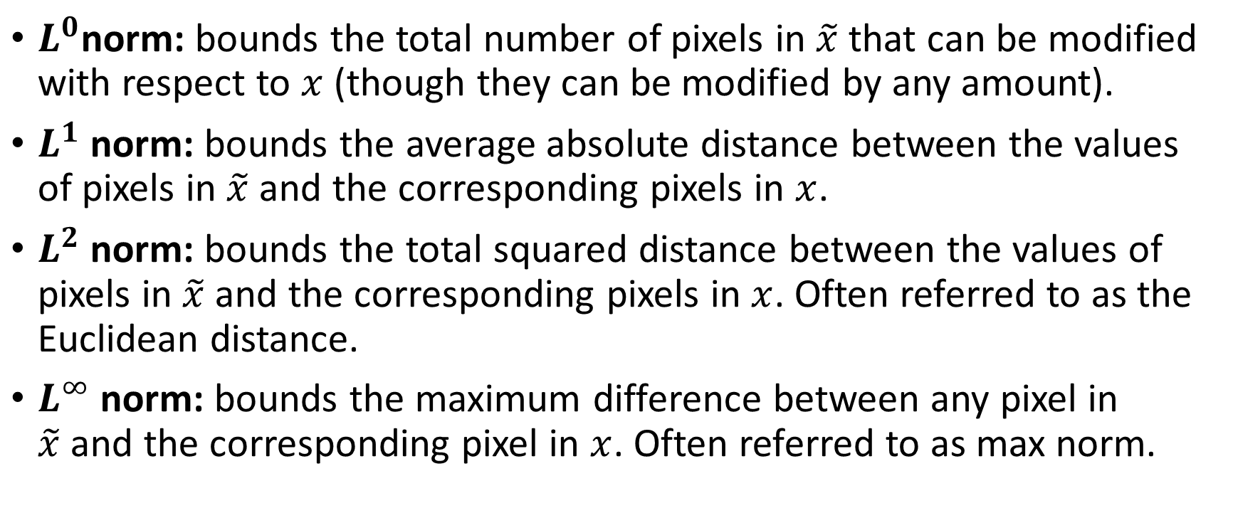
A reminder about norms
$L^{0}$norm: bounds the total number of pixels in $\tilde{x}$ that can be modified with respect to $x$ (though they can be modified by any amount).
$L^{1}$ norm: bounds the average absolute distance between the values of pixels in $\tilde{x}$and the corresponding pixels in $x$.
$L^{2}$ norm: bounds the total squared distance between the values of pixels in $\tilde{x}$and the corresponding pixels in $x$. Often referred to as the Euclidean distance.
$L^{∞}$norm: bounds the maximum difference between any pixel in $\tilde{x}$and the corresponding pixel in $x$. Often referred to as max norm.
$${\left\|\tilde{x}−x\right\|}_{∞}=\max_{i,j}\left(\left|{\tilde{x}}_{i,j}−x_{i,j}\right|\right)$$

Slide 74
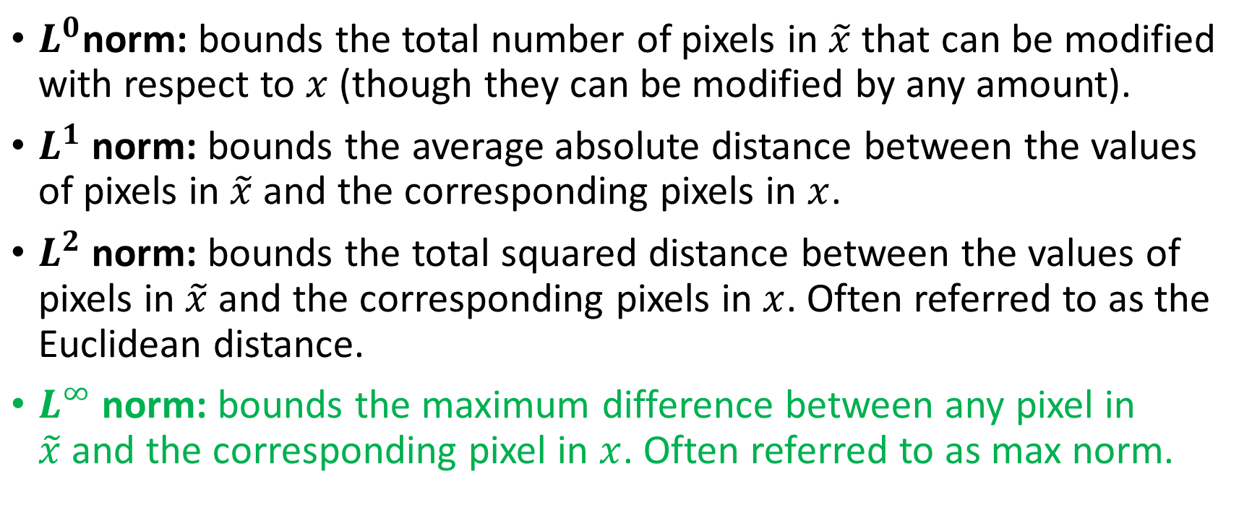
A reminder about norms
$L^{0}$norm: bounds the total number of pixels in $\tilde{x}$ that can be modified with respect to $x$ (though they can be modified by any amount).
$L^{1}$ norm: bounds the average absolute distance between the values of pixels in $\tilde{x}$and the corresponding pixels in $x$.
$L^{2}$ norm: bounds the total squared distance between the values of pixels in $\tilde{x}$and the corresponding pixels in $x$. Often referred to as the Euclidean distance.
$L^{∞}$norm: bounds the maximum difference between any pixel in $\tilde{x}$and the corresponding pixel in $x$. Often referred to as max norm.
Preferred one!
$${\left\|\tilde{x}−x\right\|}_{∞}=\max_{i,j}\left(\left|{\tilde{x}}_{i,j}−x_{i,j}\right|\right)$$

Slide 75
Impact of noise on classifiers
Expectation for Neural Networks: Just like with human perception, small changes on inputs should not yield a different label!
Unfortunately, deep learning predictions are different: Deep learning algorithms process data differently from humans, with strong discontinuities in the change of prediction as a function the inputs.
And that is the reason for their vulnerability to attacks.
Following: A tentative of explaining why that is the case (not the absolute truth, but my intuition as to why this happens!)

Slide 76
Impact of noise on classifiers
Cars
Consider the arbitrary representation, with regions and boundaries between them.
Misconception #1: the whole space of possible inputs was densely filled with training examples during training.
Misconception #2: regions are contiguous and filled with samples.
Misconception #3: the decision boundaries between classes are smooth and make perfect sense.
Cars
Dogs
Dogs
Horses
Horses
Cats
Cats
Space of all images
Space of all images

Slide 77
Impact of noise on classifiers
Consider the arbitrary representation, with regions and boundaries between them.
Misconception #1: the whole space of possible inputs was densely filled with training examples during training.
Misconception #2: regions are contiguous and filled with samples.
Misconception #3: the decision boundaries between classes are smooth and make perfect sense.
Cars
Dogs
Horses
Cats
Space of all images

Slide 78
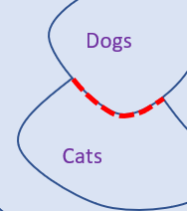
Impact of noise on classifiers
Consider the arbitrary representation, with regions and boundaries between them.
Misconception #1: the whole space of possible inputs was densely filled with training examples during training.
Misconception #2: regions are contiguous and filled with samples.
Misconception #3: the decision boundaries between classes are smooth and make perfect sense.
Cars
Dogs
Horses
Cats
Space of all images
Has a clear logic, explaining the difference between dogs and cats

Slide 79
Impact of noise on classifiers
Misconception #1: the whole space of possible inputs was densely filled with training examples during training.
Correction #1: the space is mostly noise images and sparsely filled with relevant training examples.
Also, the training samples do not cover for all possible relevant images.
Cars
Dogs
Horses
Cats
Space of all images

Slide 80
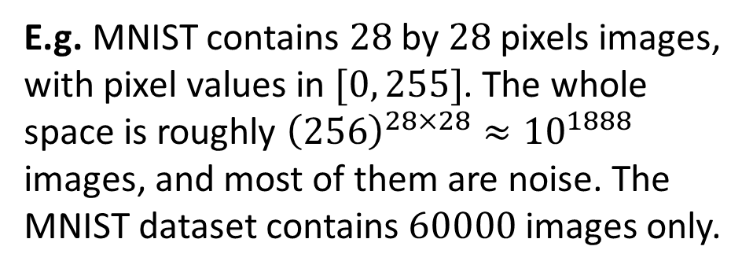
Impact of noise on classifiers
Misconception #1: the whole space of possible inputs was densely filled with training examples during training.
Correction #1: the space is mostly noise images and sparsely filled with relevant training examples.
Also, the training samples do not cover for all possible relevant images.
Cars
Dogs
Horses
Cats
Space of all images
E.g. MNIST contains $28$ by $28$ pixels images, with pixel values in $[0, 255]$. The whole space is roughly ${\left(256\right)}^{28×28}≈{10}^{1888}$ images, and most of them are noise. The MNIST dataset contains $60000$ images only.

Slide 81
Impact of noise on classifiers
Cars
Misconception #2: regions are contiguous and filled with samples.
Correction #2: regions will not necessarily be contiguous.
Cars
Dogs
Dogs
Cars
Cars
Horses
Horses
Cats
Cats
Dogs
Dogs
Cats
Cats
Space of all images

Slide 82
Impact of noise on classifiers
Cars
Misconception #2: regions are contiguous and filled with samples.
Correction #2: regions will not necessarily be contiguous. Boundaries between classes might even be very erratic!
Cars
Dogs
Dogs
Cars
Cars
Horses
Horses
Cats
Cats
Dogs
Dogs
Cats
Cats
Space of all images
Dogs
Cats

Slide 83
Impact of noise on classifiers
Misconception #3: the decision boundaries between classes are smooth and make perfect sense.
Correction #3: In fact, the boundaries between samples are often “randomly” decided.
On different epochs, the boundaries might change randomly.
Cars
Dogs
Cars
Horses
Cats
Dogs
Cats
Space of all images
Dogs
Dogs
Cats
Cats

Slide 84
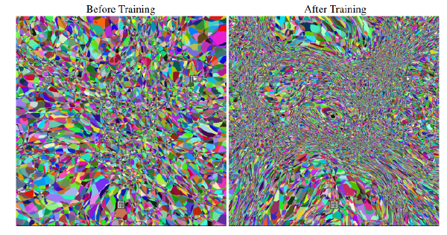
Impact of noise on classifiers
Misconception #3: the decision boundaries between classes are smooth and make perfect sense.
Correction #3: In fact, the boundaries between samples are often “randomly” decided.
On different epochs, the boundaries might change randomly.
Cars
Dogs
Cars
Horses
Cats
Dogs
Cats
Before training
After training
Space of all images
Dogs
Dogs
Cats
Cats

Slide 85
Impact of noise on classifiers
Misconception #3: the decision boundaries between classes are smooth and make perfect sense.
Correction #3-bis: Training samples are often condensed, far away from the boundaries.
Cars
Dogs
Cars
Horses
Cats
Dogs
Cats
Space of all images
Dogs
Dogs
Cats
Cats

Slide 86
Impact of noise on classifiers
Correction #3-bis: Training samples are often condensed, far away from the boundaries.
Definition (manifolds):
These small regions containing a large number of training examples are mathematically called manifolds.
See [TDS1], if curious.
Cars
Dogs
Cars
Horses
Cats
Dogs
Cats
Space of all images
Dogs
Dogs
Cats
Cats

Slide 87
Impact of noise on classifiers
Misconception #3: the decision boundaries between classes are smooth and make perfect sense.
Correction #3-bis: Training samples are often condensed, far away from the boundaries.
Boundaries decided by the Deep Learning models often exhibit the same behavior as the Support Vector Machines boundaries. But in a more random manner.
Cars
Dogs
Cars
Horses
Cats
Dogs
Cats
Space of all images
Dogs
Dogs
Cats
Cats

Slide 88
Impact of noise on classifiers
ENM prdocure, explained: When randomly noising an original sample to make an attack sample, we move randomly in the feature map.
We may even move in the boundary region, where the sample might become misclassified.
The attack sample will therefore look similar to a dog picture, but will be misclassified as a cat.
Cars
Dogs
Cars
Horses
Cats
Dogs
Cats
Space of all images
Dogs
Dogs
Cats
Cats

Slide 89
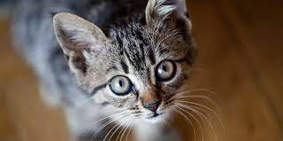
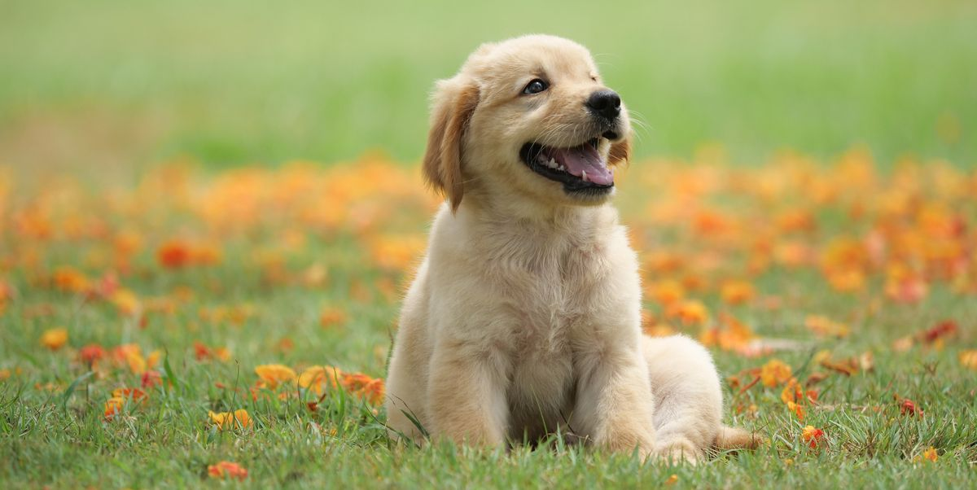
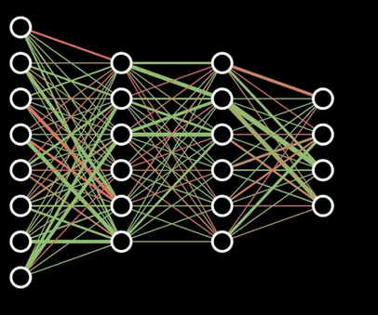
Lessons from ENM attacks
Cat or Dog Picture (high dimensional input)
Here is my intuition about attacks. (Again, not claiming it is the universal truth, free from counter examples.)
In Deep Learning, to learn means to understand that some objects are similar on certain aspects and use that for classification.
It means to discard irrelevant information which does not contribute to understand those similarities.
Neural Network, processing input image
Is the presence of fur relevant for discerning cats from dogs? No, discard info.
Is the shape of eyes relevant for discerning cats from dogs? Yes, process info.

Slide 90
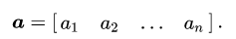
Lessons from ENM attacks
Cat or Dog Picture (high dimensional input)
Discarding information is achieved by progressively compressing input data into a space of lower dimensionality using several Neural Networks layers.
A linear neuron would achieve this, by mapping inputs onto a lower-dimension hyperplane, and learns projections of the training data.
Neural Network, processing input image
Lower dimensional vector produced by final hidden layer of Neural Network.

Slide 91
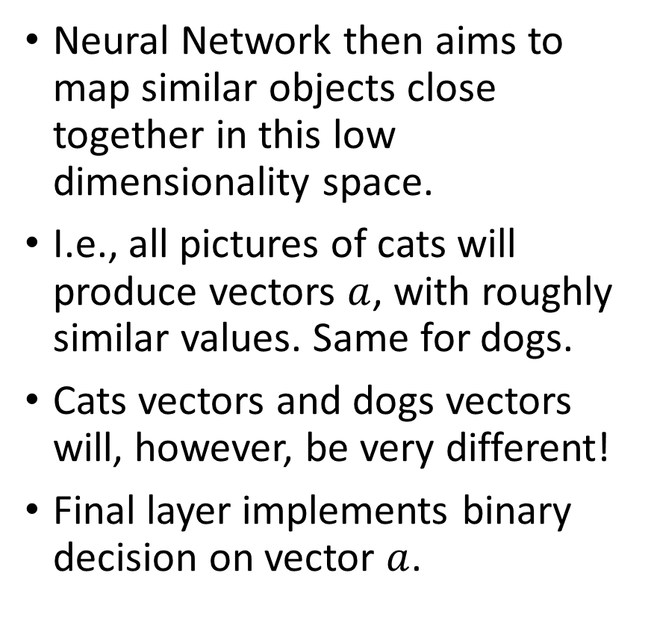
Lessons from ENM attacks
Cat or Dog Picture (high dimensional input)
Neural Network then aims to map similar objects close together in this low dimensionality space.
I.e., all pictures of cats will produce vectors $a$, with roughly similar values. Same for dogs.
Cats vectors and dogs vectors will, however, be very different!
Final layer implements binary decision on vector $a$.
Neural Network, processing input image
Lower dimensional vector produced by final hidden layer of Neural Network.

Slide 92
Lessons from ENM attacks
Cat or Dog Picture (high dimensional input)
Due to compression, there are many directions in a high dimension feature space along which a small step might lead to big changes in predictions.
In zones with low training data densities, the decision boundaries can lie very close together, because they were never properly learned from training samples!
Small change here…
Neural Network, processing input image
… Huge change here!
Lower dimensional vector produced by final hidden layer of Neural Network.

Slide 93
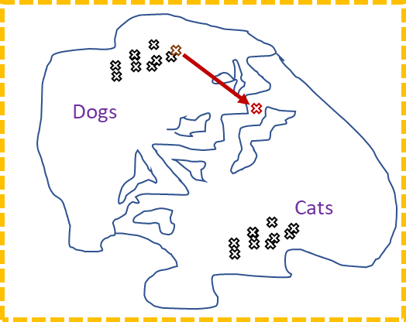
Lessons from ENM attacks
In zones with low training data densities, some small changes on an input can then lead to big changes in predictions produced by the trained Neural Network.
And that is what we exploit to generate attack samples!

Slide 94
Lessons from ENM attacks
Unfortunately, this means that all deep learning models will always be susceptible to attacks.
(And that is something we have to accept.)

Slide 95
Lessons from ENM attacks
Unfortunately, this means that all deep learning models will always be susceptible to attacks.
(And that is something we have to accept.)
So what? Is that it then?
Are Neural Networks flawed beyond repair?
Are we giving up on Neural Networks then?

Slide 96
Reason #2: Defense
Definition (Defense on Neural Networks):
In adversarial machine learning, defense refers to machine learning techniques that attempt to protect models from being attacked by malicious attempts.

Slide 97
Reason #2: Defense
Definition (Defense on Neural Networks):
In adversarial machine learning, defense refers to machine learning techniques that attempt to protect models from being attacked by malicious attempts.
Important: defense mechanisms often rely on an understanding of how attacks work.
SOMETHING FOR LATER…

Slide 98
Conclusion (W8S1)
Attacks on Neural Networks, a definition.
Our first attack, simply by noising images.
Attacks exploits intrinsic limitations that deep learning models will always have.
We can defend against attacks.
The random noise attacks are very random with unpredictable efficacy.
These random noise attacks will not necessarily move the samples towards the boundary region.
Advanced attacks techniques will improve on this matter. More on this later!
Defense mechanics will attempt to prevent these attacks from working.

Slide 99
Learn more about these topics
Out of class, supporting papers, for those of you who are curious.
[Xie2017] Xie at al., “Adversarial Examples for Semantic Segmentation and Object Detection”, 2017. https://arxiv.org/abs/1703.08603
[Szegedy2013] Szegedy et al., “Intriguing properties of neural networks”, 2013. https://arxiv.org/abs/1312.6199

Slide 100
Learn more about these topics
[Moosavi2017] Moosavi-Dezfooli et al., “Universal adversarial perturbations”, 2017. https://arxiv.org/abs/1610.08401
[Hayes2017] Hayes et al., “Learning Universal Adversarial Perturbations with Generative Models”, 2017. https://arxiv.org/abs/1708.05207
[Goodfellow2018] Goodfellow et al., “Making machine learning robust against adversarial inputs”, 2018. https://dl.acm.org/doi/10.1145/3134599

Slide 101
Learn more about these topics
Some extra (easy) reading and videos for those of you who are curious.
[Verge1] Google’s AI thinks this turtle looks like a gun, which is a problem: https://www.theverge.com/2017/11/2/16597276/google-ai-image-attacks-adversarial-turtle-rifle-3d-printed
[Spectrum1] Slight Street Sign Modifications Can Completely Fool Machine Learning Algorithms: https://spectrum.ieee.org/cars-that-think/transportation/sensors/slight-street-sign-modifications-can-fool-machine-learning-algorithms

Slide 102
Learn more about these topics
[Verge2] These glasses trick facial recognition software into thinking you're someone else: https://www.theverge.com/2016/11/3/13507542/facial-recognition-glasses-trick-impersonate-fool
[YTB1] Defeating Facial Recognition: https://www.youtube.com/watch?v=tbdcL5Ux-9Y
[TDS1] Manifolds in Data Science — A Brief Overview: https://towardsdatascience.com/manifolds-in-data-science-a-brief-overview-2e9dde9437e5

